Slide 1


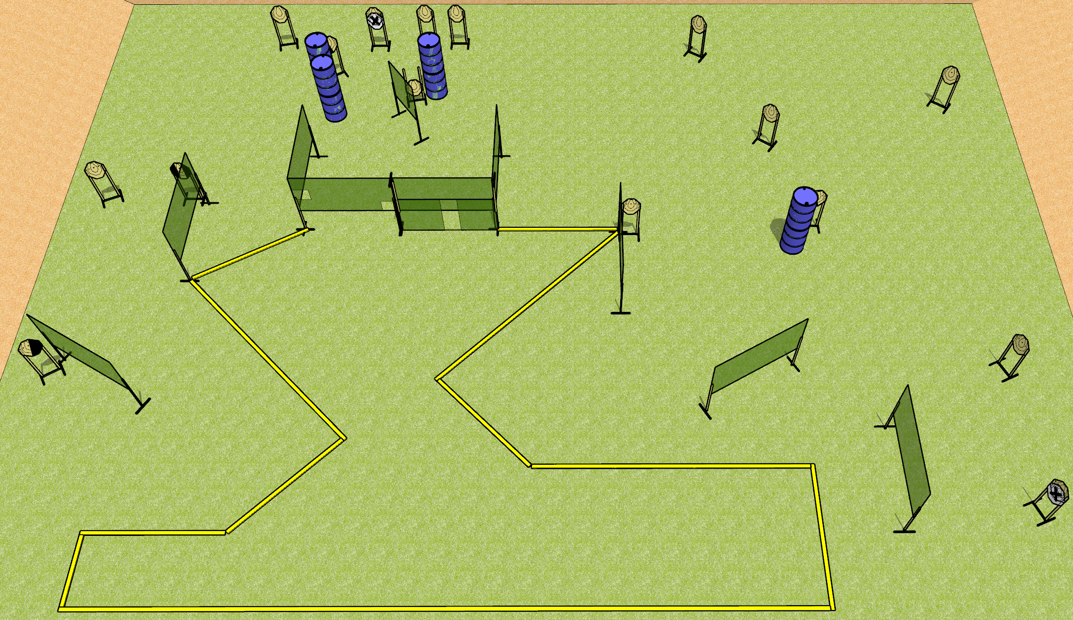
 | Dothan Gun Club – USPSA Match The World Is Not Enough Course Designer : Drew Coleman
Round Count 32 rounds 16 IPSC
Equipment List 17 wall feet 1 tux, 1 left + 1 right diag, 15 targets (13 + 2NS) All the long fault lines are 10 foot

Slide 2
The World Is Not Enough
Written Stage Briefing
Scoring: Comstock
Rounds: 32
Targets: 16 IPSC
Handgun start position: anywhere inside the shooting area, wrists below belt. Handgun is loaded and holstered.
PCC start position: anywhere inside the shooting area, stock on belt. Carbine is loaded, safety on.
Stage Procedure: on the audible start signal, engage targets as they become available from within the shooting area.

